Slide 1
Before we start...
Please go to this page and look for section 1.3
https://rawgit.com/altintasali/buildShiny/master/doc/buildShiny.html
And start installing required packages
Or alternatively
Open RStudio
Write down the commands below to your R terminal
install.packages("shiny")
install.packages("ggplot2")
install.packages("plotly")
install.packages("ggplotify")

Slide 2
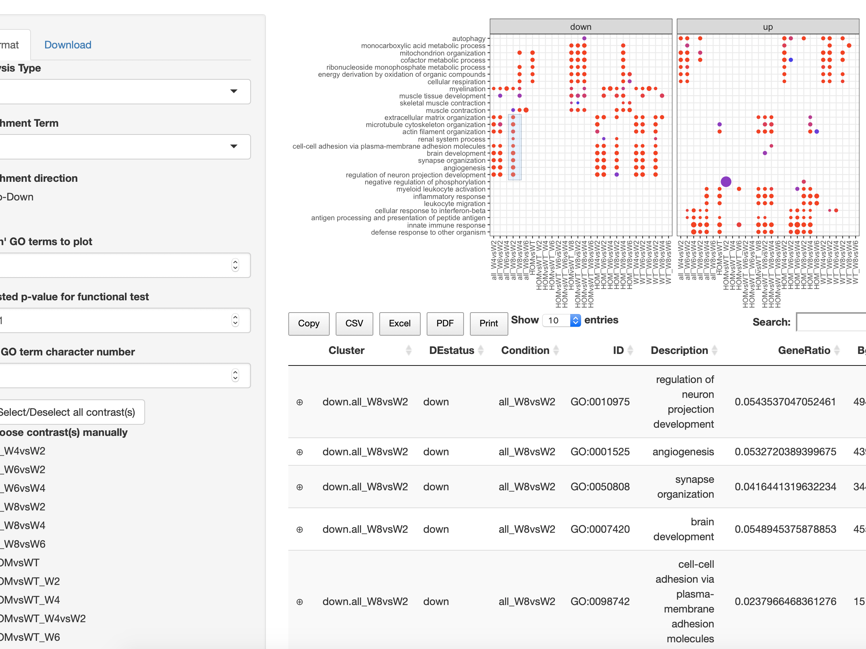
Building Your First Shiny App
Ali Altıntaş
NNF Center for Basic Metabolic Research
Barrès Lab
May 15, 2019

Slide 3
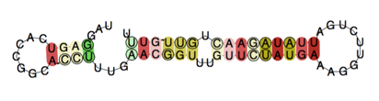
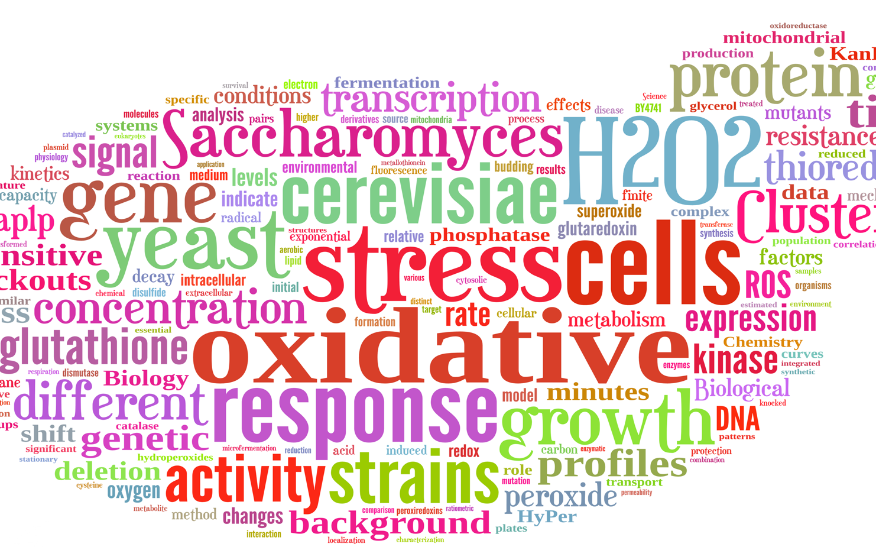
About me
1st Post-doc project: “The differential expression detection of structured RNA in inflammatory bowel disease”
(Image Courtesy: Dr. Mike Evans)
2nd Post-doc project: “Transcriptomic and epigenetic regulation of circadian clock”
PhD Thesis: “Dynamics of oxidative stress response in budding yeast”
Barres Lab

Slide 4

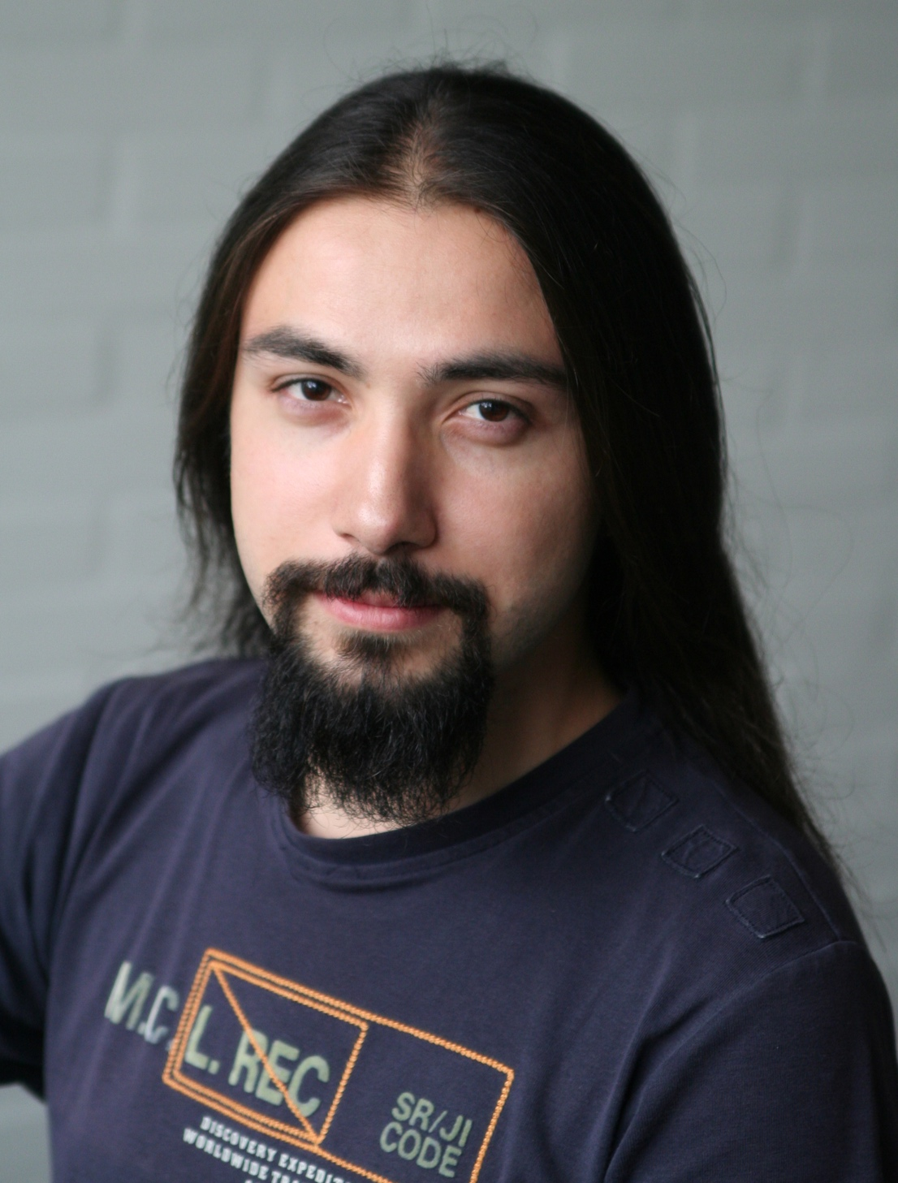
At your service today
Ali Altıntaş
Leonidas Lundell

Slide 5
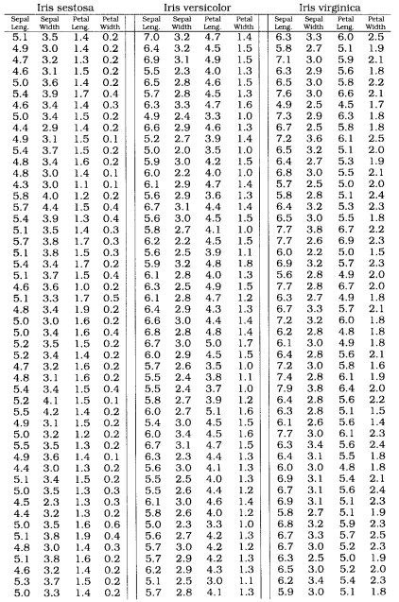
Dataset: Iris flowers
Iris versicolor
Iris setosa
Iris virginica
Source: Wikipedia
Source: Wikipedia
(Fisher, 1936)

Slide 6
What is Shiny?
Shiny is an open source R package that provides an elegant and powerful web framework for building web applications using R.
Shiny helps you turn your analyses into interactive web applications without requiring HTML, CSS, or JavaScript knowledge.

Slide 7
Main Components
Shiny app consists of 3 main components
UI: User interface object
Server: Server function
Run: A call to shinyApp function
library(shiny)
ui <- ...
server <- ...
shinyApp(ui = ui, server = server)

Slide 8
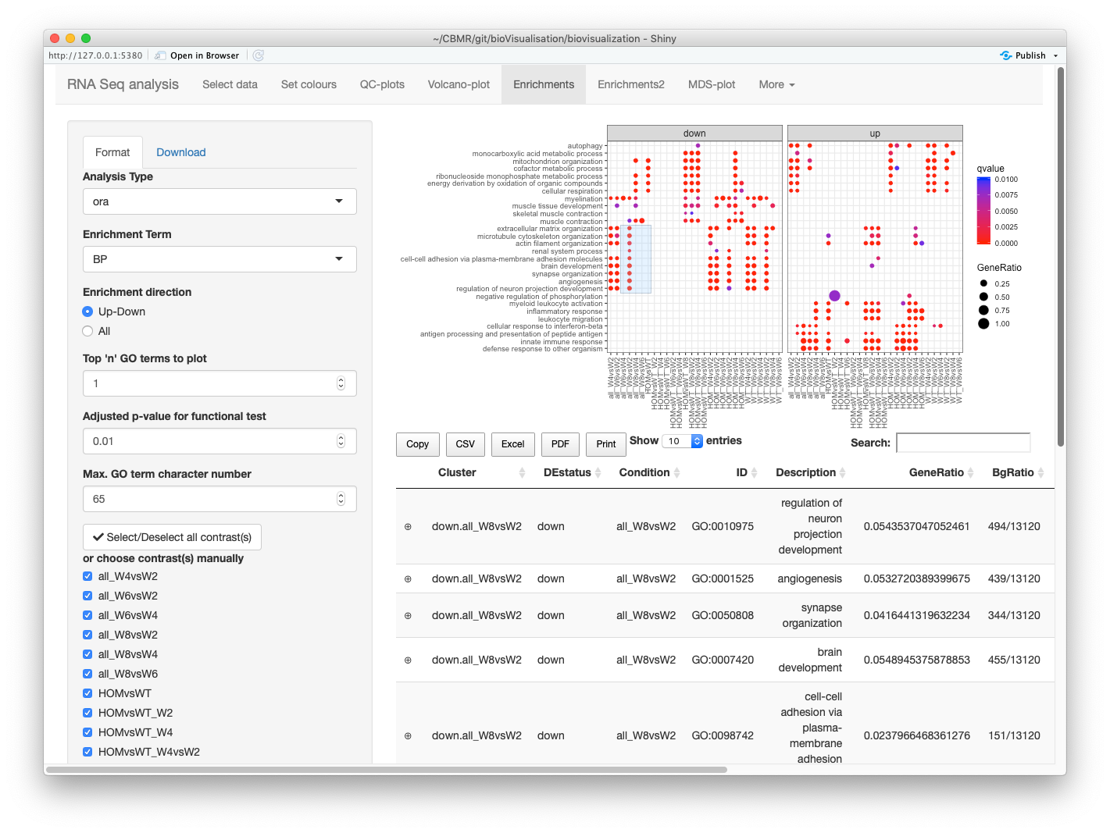
How does a Shiny App look like?

Slide 9
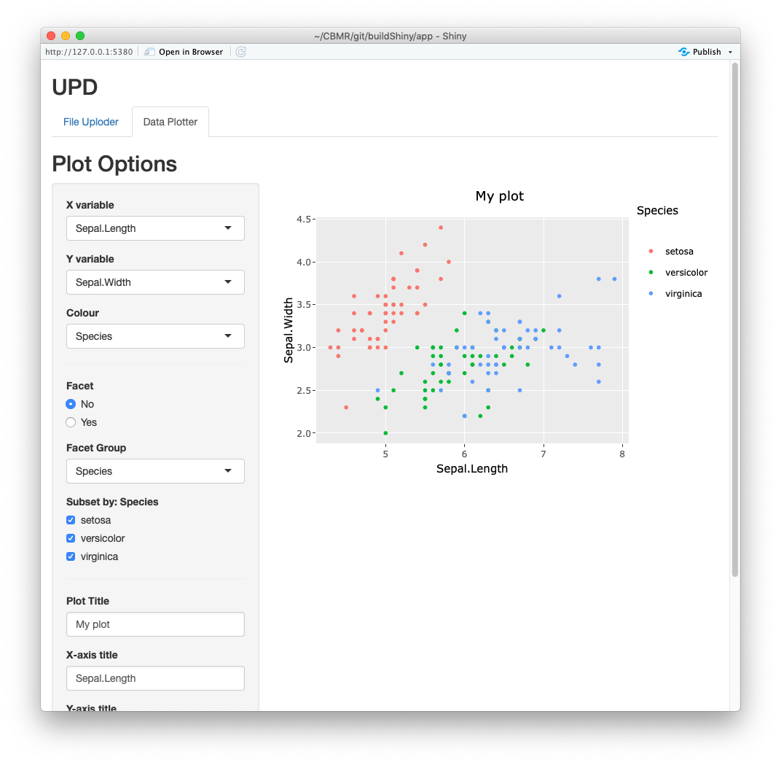
UI elements
Title
Sidebar
Main Panel
Page
Layout

Slide 10
UI functions
titlePanel()
mainPanel()
sidebarPanel()
fluidPage()
sidebarLayout()

Slide 11
Skeleton for UI script
library(shiny)
# Define UI
ui <- fluidPage(
# Page title
titlePanel("My app"),
# Sidebar layout with input and output definitions
sidebarLayout(
# Sidebar panel for inputs
sidebarPanel( ),
# Main panel for displaying outputs
mainPanel( )
)
)
# Define server logic
server <- function(input, output) { }
# Run the app
shinyApp(ui = ui, server = server)

Slide 12
Server Logic
The server takes the input from the ui
It renders the input to output to create objects
# Define UI
ui <- fluidPage(
# Page title
titlePanel("My app"),
# Sidebar layout
sidebarLayout(
# Sidebar panel for inputs
sidebarPanel(
# Input
selectInput(
inputId = “textin”,
label = ”My first text”,
choices = c(“Hello World!”,
”foo”,
”bar”),
selected = “Hello World!”
)
),
# Main panel for displaying outputs
mainPanel(
textOutput(outputId = “textout”)
)
)
)
# Define server logic
server <- function(input, output) {
output$textout <- renderText({
paste(“My first text is:”, input$textin)
})
}
# Run the app
shinyApp(ui = ui, server = server)
Note that we used:
function render*() to evaluate output
there are curly brackets “{}” inside render*() function

Slide 13
reactive() and observe()
reactive({})
observe({})
Don’t worry if it is too conceptual!
We will get “hands on” experience on this during the tutorial.
Images: https://shiny.rstudio.com/articles/understanding-reactivity.html

Slide 14

Many thanks to...
Romain
Barrès
Leonidas Lundell
Lars Roed Ingerslev
Julia
Villarroel
CBioVikings
Dmitrii
Borisevic

Slide 15
Tutorial time
Please click the link below for the tutorial
https://rawgit.com/altintasali/buildShiny/master/doc/buildShiny.html

